Slide 1
DATA STRUCTURE AND ALGORITHMS
Ashutosh Sonawane

Slide 2
Algorithm
a process or set of rules to be followed in calculations or other problem-solving operations, especially by a computer.
is a finite sequence of well-defined, computer-implementable instructions, typically to solve a class of problems or to perform a computation.
Algorithm can be written in two ways
Natural language
pseudocode
Example:- binary search algorithm
Given an array A of n elements with values or records sorted and target value T, the following subroutine uses binary search to find the index of T in A.
Set L to 0 and R to n-1.
If L>R, the search terminates as unsuccessful.
Set m (the position of the middle element) to the floor of ((L + R)/2), which is the greatest integer less than or equal to ((L + R)/2).
If Am < T, set L to m+1 and go to step 2.
If Am > T, set R to m-1 and go to step 2.
Now Am=T, the search is done; return m.
function binary_search(A, n, T) is
L := 0
R := n − 1
while L ≤ R do
m := floor((L + R) / 2)
if A[m] < T then
L := m + 1
else if A[m] > T then
R := m - 1
else:
return m
return unsuccessful

Slide 3
Flowchart
A flowchart is a type of diagram that represents a workflow or process.
A flowchart can also be defined as a diagrammatic representation of an algorithm, a step-by-step approach to solving a task.
The flowchart shows the steps as boxes of various kinds, and their order by connecting the boxes with arrows.
Flowcharts are used in analyzing, designing, documenting or managing a process or program in various fields.

Slide 4
Symbols used in flowchart
ANSI/ISO Shape | Name | Description
 | Flowline (Arrowhead) | Shows the process's order of operation. A line coming from one symbol and pointing at another. Arrowheads are added if the flow is not the standard top-to-bottom, left-to right.
 | Terminal | Indicates the beginning and ending of a program or sub-process. Represented as a stadium, oval or rounded (fillet) rectangle. They usually contain the word "Start" or "End", or another phrase signaling the start or end of a process, such as "submit inquiry" or "receive product".
 | Process | Represents a set of operations that changes value, form, or location of data. Represented as a rectangle.
 | Decision | Shows a conditional operation that determines which one of the two paths the program will take. The operation is commonly a yes/no question or true/false test. Represented as a diamond (rhombus).
 | Input / Output | Indicates the process of inputting and outputting data, as in entering data or displaying results. Represented as a parallelogram.

Slide 5
Symbols used in flowchart
ANSI/ISO Shape | Name | Description
 | Annotation (Comment) | Indicating additional information about a step in the program. Represented as an open rectangle with a dashed or solid line connecting it to the corresponding symbol in the flowchart.
 | Predefined Process | Shows named process which is defined elsewhere. Represented as a rectangle with double-struck vertical edges.
 | On-page Connector | Pairs of labeled connectors replace long or confusing lines on a flowchart page. Represented by a small circle with a letter inside.
 | Off-page Connector | A labeled connector for use when the target is on another page. Represented as a home plate-shaped pentagon.

Slide 6
More Symbols used in flowchart
Shape | Name | Description
 | Data File or Database | Data represented by a cylinder (disk drive).
 | Document | Single documents represented a rectangle with a wavy base.
 |  | Multiple documents represented stacked rectangle with a wavy base.
 | Manual operation | Represented by a trapezoid with the longest parallel side at the top, to represent an operation or adjustment to process that can only be made manually.
 | Manual input | Represented by quadrilateral, with the top irregularly sloping up from left to right, like the side view of a keyboard.
 | Preparation or Initialization | Represented by an elongated hexagon, originally used for steps like setting a switch or initializing a routine.

Slide 7
Set L to 0 and R to n-1.
If L>R, the search terminates as unsuccessful.
Set m (the position of the middle element) to the floor of ((L + R)/2), which is the greatest integer less than or equal to ((L + R)/2).
If Am < T, set L to m+1 and go to step 2.
If Am > T, set R to m-1 and go to step 2.
Now Am=T, the search is done; return m.
Start
L = 0
R = n-1
A
L > R
Yes
No
M = floor((L + R) / 2)
A
L = M+1
Yes
Am < T
No
A
Yes
Am > T
R = M-1
No
Am = T
Yes
Print found
Print not found
Stop

Slide 8
Types and usage of Algorithm
Searching Algorithm
Designed to search for data in large data collection.
Sorting Algorithm
Used to arrange data items in ascending or descending order.
Compression Algorithm
Meant to reduce the size of data, program, image, video etc.
Encoding Algorithm
Used in encryption of data
Geometric Algorithm
To identification of geometric shapes.
Pattern Algorithm
Comparing images and shapes.
Parsing Algorithm
To identify different programming construct by the compiler.

Slide 9
Classification of Algorithm
Iterative Algorithm
Certain steps are repeated in loops, until the goal is achieved.
Example sorting of an array.
Divide-and-Conquer Algorithm
A given problem is fragmented into sub-problems which are solved partially
Algorithm is terminated when further sub-division can't be performed.
Used is searching and sorting algorithm
Greedy Algorithm
In greedy algorithm an immediately available best solution at each step in chosen.
Used in scheduling and graph theory
Back-Tracking Algorithm
In back tracking algorithms all possible solutions are explored, until the end is reached and then the steps are traced back.
Used in graph theory (bfs, dfs), tree traversing, etc.

Slide 10
Performance of Algorithm
The performance of algorithm is measured on the basis of following properties.
Time complexity: It is a way of representing the amount of time needed by a program to run to the completion.
Space complexity: It is the amount of memory space required by an algorithm, during a course of its execution.
How to major time complexity?
By observe time taken by the program in sec.
But every system have different speed because of processor clock cycle speed.(1.4 GHz or 2.2 GHz) 10⁹ Hz
By identifying number of clock cycle.
It is very critical and time consuming.
#include<chrono>
Using namespace std::chrono;
Int main(){
int arr[]={98,56,78,12,45,65,89,32};
auto start = high_resolution_clock::now();
selectionSort(arr,8);
auto end = high_resolution_clock::now();
auto duration = duration_cast<microseconds>(end-start);
cout << “selection sort take ” << duration.count() << “microseconds..”;
return 0; }

Slide 11
Asymptotic Notations
Big oh Notation (Ο)
Omega Notation (Ω)
Theta Notation (θ)
Big oh Notation (O)
It is the formal way to express the upper boundary of an algorithm running time. It measures the longest amount of time, algorithm takes to complete their operation.
Omega Notation (Ω)
It is the formal way to represent the lower bound of an algorithm's running time. It measures the best amount of time an algorithm can possibly take to complete.
Theta Notation (θ)
It is the formal way to express both the upper bound and lower bound of an algorithm running time.

Slide 12
How to calculate?
If algorithm doesn’t have any loop or fix number of lines then it will run in constant time. O(1).
What if we have for loop in a code
for(int i=1; i <= 10; i++){…..}
O(1)
But if we have variable depended loop
for(int i=0; i<=x; i++){…..}
O{n}
If we have loop inside another loop
for(int i=1; i <= x; i++){
for(int j=1; j <= y; j++){…..}
}
O(n²)
If our loop iterator is increase or decrease in multiplication or division
for(int i=1;i<=n;i=i*2){…..}
O(log n)
In this loop iterator value is increase by one(+ or -)

Slide 13
//print multiplication table of given number
//find given number is prime or not
//print first n prime numbers
bool primeNumber(int num)
{
for (int i = 2; i < num / 2; i++)
{
if (num % i == 0)
return false;
}
return true;
}
void firstNPrimeNum(int num)
{
if (num >= 1)
std::cout << "First " << num << " prime numbers are:\n"<< "2 ";
int c, i = 3;
for (int count = 2; count <= num;)
{
for (c = 2; c <= i - 1; c++)
if (i % c == 0)
break;
if (c == i)
{
std::cout << i << " ";
count++;
}
i++;
}
}
void tableOf(int num)
{
for (int i = 1; i <= 10; i++)
{
std::cout << num * i << std::endl;
}
}
O(1)
O(n)
//print multiplication tables between given range
//second maximum number from array
void table(int from, int to)
{
for (int i = 1; i <= 10; i++)
{
for (int j = from; j <= to; j++)
std::cout << std::setw(4) << j * i << "|";
std::cout << std::endl;
}
}
int secondMax(int *arr, int size)
{
int max1, max2;
max1 = max2 = INT_MIN;
for (int i = 0; i < size; i++)
if (arr[i] > max1){
max2 = max1; max1 = arr[i];
}
else if (arr[i] > max2 && arr[i] < max1)
max2 = arr[i];
return max2;
}
O(n²)
O(n)
O(n)

Slide 14
Binary Search
Tree Traversal
int iterativeBsearch(int A[], int size, int element) {
int start = 0, end = size-1;
while(start<=end) {
int mid = (start+end)/2;
if( A[mid] == element)
return mid;
else if( element < A[mid] )
end = mid-1;
else
start = mid+1;
}
return -1;
}
void Tree::inorder(Node *ep)
{
if (ep != nullptr)
{
inorder(ep->getLeft());
std::cout << ep->getData() << " ";
inorder(ep->getRight());
}
}
O(log n)
int recursiveBsearch(int A[], int start, int end, int element) {
if(start>end) return -1;
int mid = (start+end)/2;
if( A[mid] == element )
return mid;
else if( element < A[mid] )
recursiveBsearch(A, start, mid-1, element);
else
recursiveBsearch(A, mid+1, end, element);
}
O(log n)

Slide 15
What is Data Structure?
In computer science, a data structure is a data organization, management, and storage format that enables efficient access and modification.
Different types of data structures are suited to different kinds of applications, and some are highly specialized to specific tasks. For example, relational databases commonly use B-tree indexes for data retrieval, while compiler implementations usually use hash tables to look up identifiers.
There are numerous types of data structures, generally built upon simpler primitive data types. For example Array, List, stack, queue, Tree graph, etc.
And the basic operation perform on this data structure are as follow
Insertion
Deletion
Traversal
Searching
Sorting
etc

Slide 16
Continue…
Data Structure
Linear
Non Linear
Array
Tree
List
Graph
Stack
Queue

Slide 17
Continue…
Data Structure
Physical
Logical
Array
Tree
List
Graph
Stack
Queue

Slide 18
Array
an Array, is a data structure consisting of a collection of elements (values or variables), each identified by at least one array index or key.
Array is a container which can hold a fix number of items and these items should be of the same type.
The memory address of the first element of an array is called first address, foundation address, or base address.
DataType ArrayName[Size]
Int arr[5]={10,20,30,40,50};
10 | 20 | 30 | 40 | 50
1000 | 1004 | 1008 | 1012 | 1016

Slide 19
Array as container (insertion)
Array arr(5);
arr.insert(50);
Ptr =1000
Size =5
GV | GV | GV | GV | GV
20
40
50
0 | 0 | 0 | 0 | 0
arr.insert(10);
arr.insert(60);
10
30
Index =
-1
0
1
2
3
4
1000 | 1004 | 1008 | 1012 | 1016
arr.insert(20);
arr.insert(30);
arr.insert(40);
Class Array{
int *ptr;
int size,index;
Array(){
index=-1; size=5; ptr= new int[5];
for(int i=0;i<5;i++)
ptr[i]=0;
}
Array(int size){
index=-1; this->size = size; ptr= new int[size];
for(int i=0;i<size;i++)
ptr[i]=0;
}
};
Class Array{
int *ptr;
int size;
Array(){
size=5; ptr= new int[5];
for(int i=0;i<5;i++)
ptr[i]=0;
}
Array(int size){
this->size = size; ptr= new int[size];
for(int i=0;i<size;i++)
ptr[i]=0;
}
};
Class Array{
int *ptr;
Array(){
ptr= new int[5];
for(int i=0;i<5;i++)
ptr[i]=0;
}
Array(int size){
ptr= new int[size];
for(int i=0;i<size;i++)
ptr[i]=0;
}
};
Class Array{
…
void insert(int data){
index++;
ptr[index]=data;
}
};
Class Array{
…
bool isFull(){
return index+1==size;
}
};
Class Array{
…
void insert(int data){
if(!this->isFull()){
index++;
ptr[index]=data;
}else{
throw “Array index OutOfBound”;
}
}
};

Slide 20
Array as container(insert first)
Array arr(5);
Ptr=1000
Size= 5
10
20
arr.insertFirst(10);
20
0
0
30
10
0
10
0
0
Index=
1
0
-1
arr.insertFirst(20);
2
1000 | 1004 | 1008 | 1012 | 1016
arr.insertFirst(30);
Class Array{
….
void insertFirst(int data){
if(!isFull()){
for(int i=index;i>=0;i--){
ptr[i+1]=ptr[i];
}
ptr[0]=data;
index++;
}else{
throw ”Array is full…”;
}
}
};
Class Array{
….
void insertFirst(int data){
for(int i=index;i>=0;i--){
ptr[i+1]=ptr[i];
}
ptr[0]=data;
index++;
}
};

Slide 21
Array as container(delete)
Array arr(5);
arr.insert(10); arr.insert(20); arr.insert(30);
prt = 1000
0
0
0
size = 5
10
20
30
0
0
-1
1
Ind =
2
0
1000 | 1004 | 1008 | 1012 | 1016
cout<<arr.remove();
cout<<arr.remove();
temp
cout<<arr.remove();
30
10
cout<<arr.remove();
20
Class Array{
….
int remove(){
if(!isEmpty()){
int temp=ptr[index];
ptr[index]=0;
index--;
return temp;
}else{
throw “Array is empty”;
}
}
};
Class Array{
…
bool isEmpty(){
return index==-1;
}
};
Class Array{
….
int remove(){
int temp=ptr[index];
ptr[index]=0;
index--;
return temp;
}
};

Slide 22
Array as container(delete first)
Array arr(5);
arr.insert(10); arr.insert(20);
arr.insert(30); arr.insert(40);
prt = 1000
20
0
40
size = 5
30
30
40
0
10
0
40
0
20
30
40
2
Index=
3
0
cout<<deleteFirst();
1
1000 | 1004 | 1008 | 1012 | 1016
cout<<deleteFirst();
cout<<deleteFirst();
temp
10
20
30
Class Array{
….
int deleteFirst(){
if(!isEmpty()){
int temp=ptr[0];
for(int i=1;i<=index;i++)
ptr[i-1]=ptr[i];
ptr[index]=0;
index--;
return temp;
}else{
throw “Array is empty”;
}
}
};
Class Array{
….
int deleteFirst(){
int temp=ptr[0];
for(int i=1;i<=index;i++)
ptr[i-1]=ptr[i];
ptr[index]=0;
index--;
return temp;
}
};

Slide 23
Destructor
Class Array{
…
~Array(){
for(int i=0;i<index; i++)
ptr[i]=0;
size=index=-1;
delete []ptr;
}
};
Stack
Heap
main
ptr = 1000
arr1
size = 5
10
20
30
index =2
1000 | 1004 | 1008 | 1012 | 1016
ptr = 2000
size = 5
40
50
60
arr2
index =2
2000 | 2004 | 2008 | 2012 | 2016
operator+
Main(){
Array arr1;
Array arr2;
arr1.insert(10); arr1.insert(20); arr1.insert(30);
arr2.insert(40); arr2.insert(50); arr2.insert(60);
arr1+arr2; arr1.operator+(arr2);
}
ptr = 2000
temp
size = 5
index =2

Slide 24
Copy Constructor And = Operator.
Class Array{
…
Array(const Array& a){
size=a.size;
index=a.index;
this->ptr=new int[this->size];
for(int i=0;i<this->size;i++){
this->ptr[i]=a.ptr[i];
}
}
};
Stack
Heap
main
ptr = 1000
arr1
size = 5
10
20
30
index =2
1000 | 1004 | 1008 | 1012 | 1016
ptr = 2000
size = 5
40
50
60
arr2
index =2
2000 | 2004 | 2008 | 2012 | 2016
operator+
Array operator=(const Array& a){
this->index=a.index;
this->size=a.size;
delete []this->ptr;
this->ptr=new int[this->size];
for(int i=0;i<this->size;i++){
this->ptr[i]=a.ptr[i];
}
return *this;
}
ptr = 3000
40
size = 5
50
60
arr2
index =2
3000 | 3004 | 3008 | 3012 | 3016

Slide 25
More operation on Array
Display (operator <<)
At (operator[])
Operator == OR operator!=
Operator+ OR Operator-
Max and min
Sum and avg
Left rotate
Resize or grow
Element occurrence count

Slide 26
Some programs frequently asked in coding round
Find second largest number in an integer array, without sorting the array. E.g. {4,5,7,11,9,13,8,12,10} Ans:12
Write a program to find all pairs of elements in the given array whose sum is equal to a given number. E.g. if {4,5,7,11,9,13,8,12,10} is an array and 20 is the given number, then you have to find all pairs of elements in this array whose sum must be 20. in this example (9,11) (7,13) and (8,12)are such pairs whose sum is 20.
Given an array of integers determine whether each is a power of 2. power of 2 are [1,2,4,8,16,32,64,…] for each element tested append either an integer 1 id the numer is a power of 2, or a 0 otherwise. E.g. if arr={1,3,8,12,16} then return array is ans = {1,0,1,0,1}
Print the number with their count( occurrence ) in array. E.g arr={10,20,10,30,20,10,40} then ans 10=3 , 20=2 , 30=1 , 40=1
Consider N walls, each of unit width, situated next to each other. You have to select any two walls i and j (1<=i , j<= N) such that if you break all the walls except i and j and fill the spaces between them with water, then the amount of water stored is maximum. Write a program to find the maximum amount of water that can be accumulated between the walls.
Write a function which takes an array of int and returns the sum of all the integers in that whose last digit is 7, or are greater than 100, but not both. Your function must be called func and should have this signature. int func(int array[], int len)

Slide 27
LinkedList
a linked list is a linear collection of data elements, whose order is not given by their physical placement in memory. Instead, each element points to the next. It is a data structure consisting of a collection of nodes which together represent a sequence.
In its most basic form, each node contains: data, and a reference (in other words, a link) to the next node in the sequence.
A linked list is a linear data structure, in which the element are not stored at contiguous memory location.
The elements in a linked list are linked using pointer. This pointer is called node.
Data
Linked
head
10 | 200
20 | 300
30 | null
100
100
200
300
Node
Above linked list contained online one link to the next node their for this list is called as singly linked list.

Slide 28
Array | Linked List
Arrays are linear data structure . | Linked list are linear and non linear data structure.
An array is the data structure that contains a collection of similar type data elements. | linked list is considered as non-primtiive data structure contains a collection of unordered linked elements known as nodes.
In the array the elements belong to indexes, i.e., if you want to get into the fourth elements you have to write the variable name with its or location within the square bracket. | In a linked list though, you have to start from the head and work your way though until you get to the fourth element.
Accessing an element in an array is fast. | Linked list takes liner time so it is quite a bit slower.
Element are stored consecutively in array. | Element are stored randomly in linked list.
Operation like insertion and deletion in arrays consume a lot of time | Operation like insertion and deletion is fast
In array memory is assigned during compile time | In linked list memory allocated during execution or runtime.
Size of arrays is fixed | Size of linked list dynamic and flexible and can expand and contract its size.

Slide 29
How LinkedList is work
LinkedList ll;
main
ll
30
NULL
2000
10
NULL
4000
ll.insertFirst(10);
head
3000
ll.insertFirst(20);
1000
1000
3000
2000
ll.insertFirst(30);
NULL
20
NULL
40
NULL
ll.insertLast(40);
1000
2000
4000
98756
insertLast
*this
insertFirst
data
98756
10
20
30
40
*temp
*IT
1000
2000
3000
4000
1000
3000
2000

Slide 30
LinkedList (Insert First)
20
NULL
1000
LinkedList ll;
2000
ll.insertFirst(10);
10
NULL
2000
Head =
1000
NULL
3000
ll.insertFirst(20);
NULL
1000
ll.insertFirst(30);
Tail =
1000
30
NULL
2000
3000
Class LinkedList{
void insertFirst(int data){
Node *nn = new Node(data);
if (isEmpty())
{
this->head = this->tail = nn;
}
else
{
nn->setNext(this->head);
this->head = nn;
}
}
}
Class LinkeList{
bool isEmpty(){
return this->head == nullptr && this->tail == nullptr;
}
}

Slide 31
LinkedList (insert Last)
10
2000
30
NULL
LinkedList ll;
NULL
ll.insertLast(10);
Head =
1000
1000
3000
NULL
ll.insertLast(20);
3000
2000
1000
ll.insertLast(30);
Tail =
NULL
20
3000
NULL
2000
Class LinkedList{
void insertLast(int data){
Node *nn = new Node(data);
if (this->head == nullptr)
{
this->head = this->tail = nn;
}
else
{
this->tail->setNext(nn);
tail = nn;
}
}
}
Class LinkeList{
bool isEmpty(){
return this->head == nullptr && this->tail == nullptr;
}
}

Slide 32
LinkedList (Delete First)
10
2000
30
NULL
LinkedList ll;
cout<<ll.deleteFirst();
NULL
ll.insertLast(10);
cout<<ll.deleteFirst();
1000
1000
3000
Head =
2000
NULL
3000
ll.insertLast(20);
3000
2000
1000
ll.insertLast(30);
Tail =
NULL
20
3000
NULL
Data
*it
2000
2000
20
1000
Class LinkedList{
void insertLast(int data){
if (isEmpty())
throw "Linked list is empty...";
Node *ep = this->head;
this->head = this->head->getNext();
if (this->head == nullptr)
this->tail = nullptr;
int data = ep->getData();
delete ep;
this->len--;3
return data;
}
}
10

Slide 33
LinkedList (Delete Last)
10
NULL
30
NULL
LinkedList ll;
2000
Head =
1000
NULL
ll.insertLast(10);
cout<<ll.deleteLast();
1000
3000
2000
Tail =
3000
NULL
ll.insertLast(20);
cout<<ll.deleteLast();
1000
ll.insertLast(30);
20
NULL
Data
*it
3000
Class LinkedList{
void insertLast(int data){
if (isEmpty()) throw "Linked list is empty...";
Node *ep = this->head;
if (ep->getNext() == nullptr)
this->head = this->tail = nullptr;
else
{
while (ep->getNext() != this->tail)
ep = ep->getNext();
this->tail = ep;
ep = this->tail->getNext();
this->tail->setNext(nullptr);
}
int data = ep->getData();
delete ep; return data;
}
}
20
3000
2000
30
1000
2000

Slide 34
Circular LinkedList
Class CLL{
void insertAtEnd(int data)
{
Node *nn = new Node(data);
if (isEmpty())
{
this->last = nn;
nn->setNext(this->last);
}
else
{
nn->setNext(last->getNext());
this->last->setNext(nn);
this->last = nn;
}
}
};
Class CLL{
void insertAtBeginning(int data)
{
Node *nn = new Node(data);
if (isEmpty())
{
this->last = nn;
nn->setNext(this->last);
}
else
{
nn->setNext(this->last->getNext());
this->last->setNext(nn);
}
}
};

Slide 35
Circular LinkedList
Class CLL{
void deleteAtFront()
{
if (isEmpty())
throw "Linked list is empty...";
Node *ep = this->last->getNext();
this->last->setNext(ep->getNext());
if (ep == this->last)
this->last = nullptr;
int data = ep->getData();
delete ep;
return data;
}
};
Class CLL{
void insertAtBeginning(int data)
{
if (isEmpty())
throw "Linked list is empty...";
Node *ep = this->last->getNext();
if (ep->getNext() == last;
this->last = nullptr;
else
{
while (ep->getNext() != this->last)
ep = ep->getNext();
this->last = ep;
ep = this->last->getNext();
this->last->setNext(ep->getNext());
}
int data = ep->getData();
delete ep;
return data;
}
};

Slide 36
Doubly LinkedList
A doubly linked list is a linked data structure that consists of a set of sequentially linked records called nodes.
Each node contains three fields: two link fields (references to the previous and to the next node in the sequence of nodes) and one data field.
The beginning and ending nodes' previous and next links, respectively, point to some kind of terminator, typically a sentinel node or null, to facilitate traversal of the list.
The two node links allow traversal of the list in either direction.
While adding or removing a node in a doubly linked list requires changing more links than the same operations on a singly linked list, the operations are simpler and potentially more efficient (for nodes other than first nodes) because there is no need to keep track of the previous node during traversal or no need to traverse the list to find the previous node, so that its link can be modified.
The first and last nodes of a doubly linked list are immediately accessible (i.e., accessible without traversal, and usually called head and tail) and therefore allow traversal of the list from the beginning or end of the list respectively.
The link fields of a doubly linked list node are often called next and previous or forward and backward.
Previous
Data
Next
head
100
NULL | 10 | 200
100 | 20 | 300
200 | 30 | NULL
300
tail
100
200
300
Node

Slide 37
Doubly LinkedList (Insert First)
2000
NULL
NULL
 | 10 | NULL
LinkedList ll;
NULL | 30
2000
Head=
2000
NULL
1000
ll.insertFirst(10);
3000
1000
Tail=
NULL
1000
 | 20
3000
NULL
ll.insertFirst(20);
NULL
1000
ll.insertFirst(30);
2000
Class LinkedList{
void insertFirst(int data)
{
Node *nn = new Node(data);
if (isEmpty())
this->head = this->tail = nn;
else
{
nn->setNext(this->head);
this->head->setPrev(nn);
this->head = nn;
}
}
};

Slide 38
Doubly LinkedList (Insert Last)
2000
 | 30 | NULL
2000
NULL
NULL
LinkedList ll;
NULL | 10
Head=
NULL
1000
3000
ll.insertLast(10);
Tail=
2000
1000
NULL
1000
3000
NULL
1000
 | 20
NULL
3000
ll.insertLast(20);
ll.insertLast(30);
2000
Class LinkedList{
void insertLast(int data)
{
Node *nn = new Node(data);
if (isEmpty())
this->head = this->tail = nn;
else
{
this->tail->setNext(nn);
nn->setPrev(tail);
tail = nn;
}
}
};

Slide 39
Doubly LinkedList (Delete First)
2000
 | 30 | NULL
2000
NULL
NULL
LinkedList ll;
NULL | 10
Head=
NULL
1000
3000
ll.insertLast(10);
Tail=
2000
1000
NULL
1000
3000
NULL
1000
 | 20
NULL
3000
ll.insertLast(20);
ll.insertLast(30);
2000
Class LinkedList{
void deleteFirst(int data)
{
if (isEmpty())
throw "Linked list is empty...";
Node *ep = this->head;
this->head = this->head->getNext();
this->head->setPrev(nullptr);
if (this->head == nullptr)
this->tail = nullptr;
int data = ep->getData();
delete ep;
return data;
}
};

Slide 40
Doubly LinkedList (Delete Last)
2000
 | 30 | NULL
2000
NULL
NULL
LinkedList ll;
NULL | 10
Head=
NULL
1000
3000
ll.insertLast(10);
Tail=
2000
1000
NULL
1000
3000
NULL
1000
 | 20
NULL
3000
ll.insertLast(20);
ll.insertLast(30);
2000
Class LinkedList{
void deleteLast(int data)
{
if (isEmpty())
throw "Linked list is empty...";
Node *ep = this->head;
if (ep->getNext() == nullptr)
this->head = this->tail = nullptr;
else
{
ep = this->tail;
this->tail = ep->getPrev();
this->tail->setNext(nullptr);
}
int data = ep->getData();
delete ep;
return data;
}
};

Slide 41
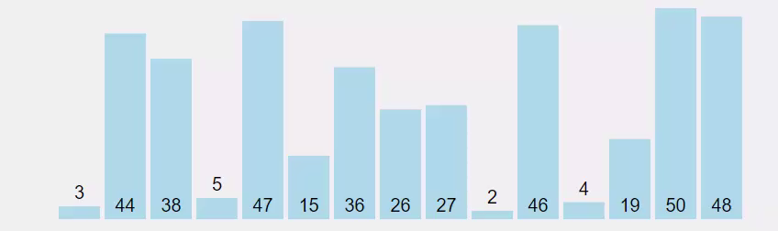
Selection Sort
In selection sort, the smallest value among the unsorted elements of the array is selected in every pass and inserted to its appropriate position into the array.
First, find the smallest element of the array and place it on the first position. Then, find the second smallest element of the array and place it on the second position. The process continues until we get the sorted array.
The array with n elements is sorted by using n-1 pass of selection sort algorithm.
In 1st pass, smallest element of the array is to be found along with its index pos. then, swap A[0] and A[pos]. Thus A[0] is sorted, we now have n -1 elements which are to be sorted.
In 2nd pas, position pos of the smallest element present in the sub-array A[n-1] is found. Then, swap, A[1] and A[pos]. Thus A[0] and A[1] are sorted, we now left with n-2 unsorted elements.
In n-1th pass, position pos of the smaller element between A[n-1] and A[n-2] is to be found. Then, swap, A[pos] and A[n-1].

Slide 42
void sort(int *arr, int size)
{
int minIndex;
for (int i = 0; i < size; i++)
{
minIndex = i;
for (int j = i + 1; j < size; j++)
{
if (arr[minIndex] > arr[j])
minIndex = j;
}
swap(arr[i], arr[minIndex]);
}
}
void swap(int &a, int &b)
{
int temp = a;
a = b;
b = temp;
}

Slide 43
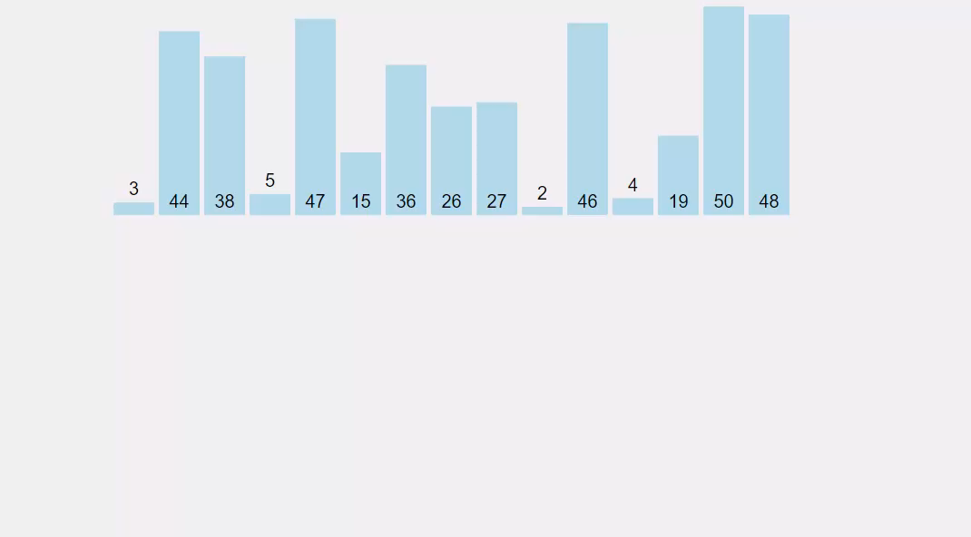
Bubble Sort
In Bubble sort, Each element of the array is compared with its adjacent element. The algorithm processes the list in passes.
A list with n elements requires n-1 passes for sorting. Consider an array A of n elements whose elements are to be sorted by using Bubble sort.
The algorithm processes like following.
In Pass 1, A[0] is compared with A[1], A[1] is compared with A[2], A[2] is compared with A[3] and so on. At the end of pass 1, the largest element of the list is placed at the highest index of the list.
In Pass 2, A[0] is compared with A[1], A[1] is compared with A[2] and so on. At the end of Pass 2 the second largest element of the list is placed at the second highest index of the list.
In pass n-1, A[0] is compared with A[1], A[1] is compared with A[2] and so on. At the end of this pass. The smallest element of the list is placed at the first index of the list.

Slide 44
void sort(int *arr, int size)
{
bool temp;
for (int i = 0; i < size; i++)
{
temp = false;
for (int j = 0; j < size - i - 1; j++)
{
if (arr[j] > arr[j + 1])
{
swap(arr[j], arr[j + 1]);
temp = true;
}
}
if (temp == false)
{
break;
}
}
}

Slide 45
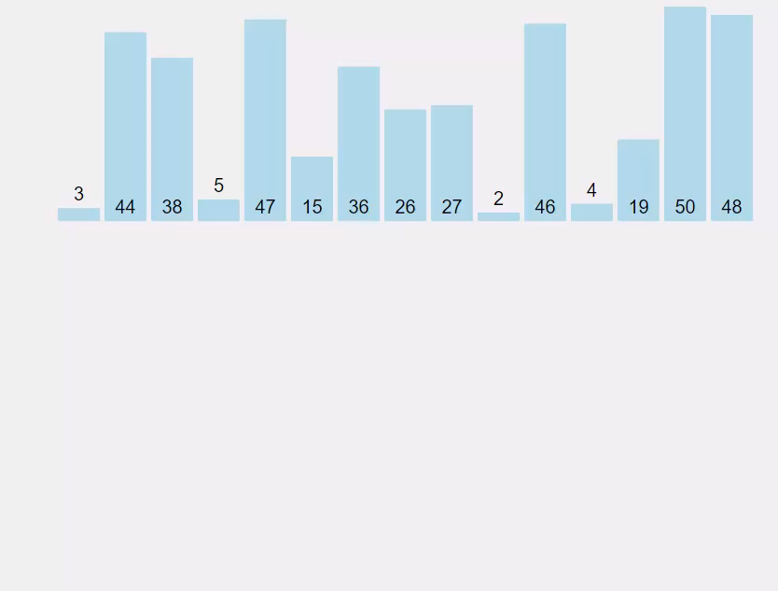
Insertion Sort
Insertion sort is the simple sorting algorithm which is commonly used in the daily lives while ordering a deck of cards.
In this algorithm, we insert each element onto its proper place in the sorted array. This is less efficient than the other sort algorithms like quick sort, merge sort, etc.
Consider an array A whose elements are to be sorted. Initially, A[0] is the only element on the sorted set. In pass 1, A[1] is placed at its proper index in the array.
In pass 2, A[2] is placed at its proper index in the array. Likewise, in pass n-1, A[n-1] is placed at its proper index into the array.
To insert an element A[k] to its proper index, we must compare it with all other elements i.e. A[k-1], A[k-2], and so on until we find an element A[j] such that, A[j]<=A[k].
All the elements from A[k-1] to A[j] need to be shifted and A[k] will be moved to A[j+1].

Slide 46
void sort(int *arr, int size)
{
int key, j;
for (int i = 1; i < size; i++)
{
key = arr[i];
j = i - 1;
while (j >= 0 && arr[j] > key)
{
arr[j + 1] = arr[j];
j--;
}
arr[j + 1] = key;
}
}

Slide 47
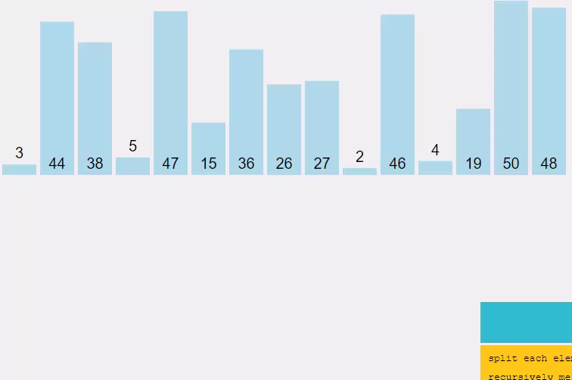
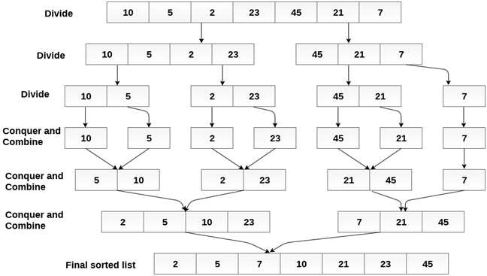
Merge Sort
Merge sort is the algorithm which follows divide and conquer approach. Consider an array A of n number of elements. The algorithm processes the elements in 3 steps.
If A Contains 0 or 1 elements then it is already sorted, otherwise, Divide A into two sub-array of equal number of elements.
Conquer means sort the two sub-arrays recursively using the merge sort.
Combine the sub-arrays to form a single final sorted array maintaining the ordering of the array.
The main idea behind merge sort is that, the short list takes less time to be sorted.

Slide 48
void mergeSort(int *arr, int l, int r)
{
if (l < r)
{
int m = l + (r - l) / 2;
mergeSort(arr, l, m);
mergeSort(arr, m + 1, r);
merge(arr, l, m, r);
}
}
void merge(int *arr, int l, int m, int r)
{
//create left right array
int n1 = m - l + 1; int n2 = r - m;
int *arr_L = new int[n1]; int *arr_r = new int[n2];
//copy left and rigth array
for (int i = 0; i < n1; i++)
arr_L[i] = arr[l + i];
for (int i = 0; i < n2; i++)
arr_r[i] = arr[(m + 1) + i];
//merge both array into main array with comp
int i = 0; //left array
int j = 0; //right array
int k = l; //main array while (i < n1 && j < n2) {
if (arr_L[i] <= arr_r[j]) {
arr[k] = arr_L[i];
i++;
}else {
arr[k] = arr_r[j];
j++;
}
k++;
}
//remaining element //left array
while (i < n1){
arr[k] = arr_L[i];
i++; k++;
}
//right array
while (j < n2){
arr[k] = arr_r[j];
j++; k++;
}
//delete both left right array;
delete[] arr_L; delete[] arr_r;
}

Slide 49
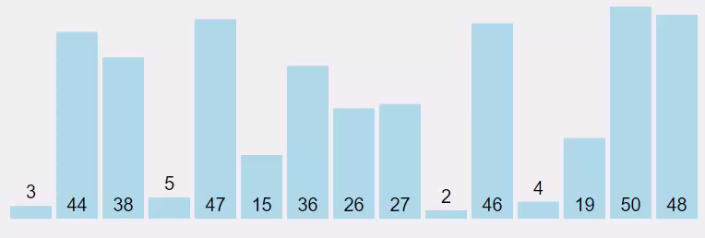
Quick Sort
Quick sort is the widely used sorting algorithm that makes n log n comparisons in average case for sorting of an array of n elements. This algorithm follows divide and conquer approach. The algorithm processes the array in the following way.
Set the first index of the array to left and loc variable. Set the last index of the array to right variable. i.e. left = 0, loc = 0, right = n - 1, where n is the length of the array.
Start from the right of the array and scan the complete array from right to beginning comparing each element of the array with the element pointed by loc.
Ensure that, a[loc] is less than a[right].
If this is the case, then continue with the comparison until right becomes equal to the loc.
If a[loc] > a[right], then swap the two values. And go to step 3.
Set, loc = right
start from element pointed by left and compare each element in its way with the element pointed by the variable loc. Ensure that a[loc] > a[left]
if this is the case, then continue with the comparison until loc becomes equal to left.
[loc] < a[right], then swap the two values and go to step 2.
Set, loc = left.

Slide 50
void quickSort(int *arr, int l, int r)
{
if (l < r)
{
int pi = partition(arr, l, r);
quickSort(arr, l, pi - 1);
quickSort(arr, pi + 1, r);
}
}
int partition(int *arr, int l, int r)
{
int pivot = arr[r];
int i = l - 1;
for (int j = l; j <= r - 1; j++)
{
if (arr[j] < pivot)
{
i++;
swap(arr[i], arr[j]);
}
}
i++;
swap(arr[i], arr[r]);
return i;
}

Slide 51
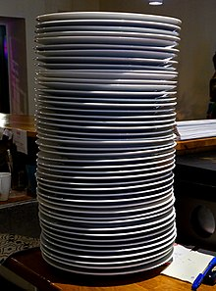
Stack
Stack is a linear data structure which follows a particular order in which the operations are performed.
The order may be LIFO(Last In First Out) or FILO(First In Last Out).
two principal operations are
push, which adds an element to the stack.
pop, which removes the most recently added element that was not yet removed
peek, which may give access to the top without modifying the stack
Stack commonly used in
Expression Evaluation.(Infix, Postfix, Prefix)
Check for balanced parentheses in an expression
Tree traversal

Slide 52
Stack using Array (push)
Stack s(5);
s.push(50);
Ptr =1000
Size =5
GV | GV | GV | GV | GV
20
40
50
0 | 0 | 0 | 0 | 0
s.push(10);
s.push(60);
10
30
-1
3
Top =
2
0
4
1
1000 | 1004 | 1008 | 1012 | 1016
s.push(20);
s.push(30);
s.push(40);
Class Stack{
…
void push(int data){
if(!this->isFull()){
top++;
ptr[top]=data;
}else{
throw “Stack is full…”;
}
}
};
Class Stack{
int *ptr;
int size,top;
Stack(){
top=-1; size=5; ptr= new int[5];
for(int i=0;i<5;i++)
ptr[i]=0;
}
Stack(int size){
top=-1; this->size = size; ptr= new int[size];
for(int i=0;i<size;i++)
ptr[i]=0;
}
};
Class Stack{
…
void push(int data){
top++;
ptr[top]=data;
}
};
Class Stack{
int *ptr;
int size;
Stack(){
size=5; ptr= new int[5];
for(int i=0;i<5;i++)
ptr[i]=0;
}
Stack(int size){
this->size = size; ptr= new int[size];
for(int i=0;i<size;i++)
ptr[i]=0;
}
};
Class Stack{
…
bool isFull(){
return top+1==size;
}
};

Slide 53
Stack using Array(pop)
Stack s(5);
s.push(10); s.push(20); s.push(30);
prt = 1000
0
0
0
size = 5
10
20
30
0
0
-1
top =
1
2
0
1000 | 1004 | 1008 | 1012 | 1016
cout<<s.pop();
cout<<s.pop();
temp
cout<<s.pop();
30
10
cout<<s.pop();
20
Class Stack{
….
int pop(){
if(!isEmpty()){
int temp=ptr[top];
ptr[top]=0;
top--;
return temp;
}else{
throw “Stack is empty”;
}
}
};
Class Stack{
…
bool isEmpty(){
return top==-1;
}
};
Class Stack{
….
int pop(){
int temp=ptr[top];
ptr[top]=0;
top--;
return temp;
}
};

Slide 54
What is infix notation?
When the operator is written in between the operands, then it is known as infix notation. Operand does not have to be always a constant or a variable; it can also be an expression itself.
For example, (p + q) * (r + s)
The above problem can be resolved by following the operator precedence rules. In the algebraic expression, the order of the operator precedence is given in the below table:
Operators | Symbols
Parenthesis | ( ), {}, [ ]
Exponents | ^
Multiplication and Division | *, /
Addition and Subtraction | + , -
Problem with infix notation
To evaluate the infix expression, we should know about the operator precedence rules, and if the operators have the same precedence, then we should follow the associativity rules. The use of parenthesis is very important in infix notation to control the order in which the operation to be performed. Parenthesis improves the readability of the expression. An infix expression is the most common way of writing expression, but it is not easy to parse and evaluate the infix expression without ambiguity. So, mathematicians and logicians studied this problem and discovered two other ways of writing expressions which are prefix and postfix. Both expressions do not require any parenthesis and can be parsed without ambiguity. It does not require operator precedence and associativity rules.

Slide 55
What is Postfix notation?
The postfix expression is an expression in which the operator is written after the operands.
For example, the postfix expression of infix notation ( 2+3) can be written as 23+.
Some key points regarding the postfix expression are:
In postfix expression, operations are performed in the order in which they have written from left to right.
It does not any require any parenthesis.
We do not need to apply operator precedence rules and associativity rules.
Evaluation of postfix expression using stack.
Scan the expression from left to right.
If we encounter any operand in the expression, then we push the operand in the stack.
When we encounter any operator in the expression, then we pop the corresponding operands from the stack.
When we finish with the scanning of the expression, the final value remains in the stack.

Slide 56
Conversion of infix to postfix
Rules for the conversion from infix to postfix expression
Print the operand as they arrive.
If the stack is empty or contains a left parenthesis on top, push the incoming operator on to the stack.
If the incoming symbol is '(', push it on to the stack.
If the incoming symbol is ')', pop the stack and print the operators until the left parenthesis is found.
If the incoming symbol has higher precedence than the top of the stack, push it on the stack.
If the incoming symbol has lower precedence than the top of the stack, pop and print the top of the stack. Then test the incoming operator against the new top of the stack.
If the incoming operator has the same precedence with the top of the stack then use the associativity rules. If the associativity is from left to right then pop and print the top of the stack then push the incoming operator. If the associativity is from right to left then push the incoming operator.
At the end of the expression, pop and print all the operators of the stack.

Slide 57
Infix to Postfix
K + L - M*N + (O^P) * W/U/V * T + Q
KL+MN*-OP^W*U/V/T*Q+
Input Expression | Stack | Postfix Expression
K |  | K
+ | +
L | + | K L
- | - | K L+
M | - | K L+ M
* | - * | K L+ M
N | - * | K L + M N
+ | + | K L + M N* K L + M N* -
( | + ( | K L + M N *-
O | + ( | K L + M N * - O
^ | + ( ^ | K L + M N* - O
P | + ( ^ | K L + M N* - O P
) | + | K L + M N* - O P ^
* | + * | K L + M N* - O P ^
W | + * | K L + M N* - O P ^ W
/ | + / | K L + M N* - O P ^ W *
U | + / | K L + M N* - O P ^W*U
/ | + / | K L + M N* - O P ^W*U/
V | + / | KL + MN*-OP^W*U/V
* | + * | KL+MN*-OP^W*U/V/
T | + * | KL+MN*-OP^W*U/V/T
+ | + | KL+MN*-OP^W*U/V/T* KL+MN*-OP^W*U/V/T*+
Q | + | KL+MN*-OP^W*U/V/T*Q

Slide 58
Infix to Prefix
Reverse the infix expression.
Find the postfix of reverse expression.
Once you get Postfix output.
Again reverse the output.
You will get Prefix expression.

Slide 59

Queue
a queue is a collection of entities that are maintained in a sequence and can be modified by the addition of entities at one end of the sequence and removal from the other end of the sequence.
It is often referred as First In First Out (FIFO).
Terminology associated with is
Rear, means from where data is added to collection.
Front, means from where data is removed from collection.
Operation perform on queue are
Enqueue, means adding data
Dequeue, means deleting data.
Queue commonly used in
Level wise tree traversal
Breadth First Traversal or BFS for a Graph
Page replacement algorithm program
Front
Rear

Slide 60
Queue using array(Enqueue)
Queue q(5);
ptr=2000
q.enqueue(10);
size=5
2
10
20
30
q.enqueue(20);
-1
1
Rear =
0
q.enqueue(30);
index=-1
2000 | 2004 | 2008 | 2012 | 2016
front=
-1
0
Class Queue{
….
void enqueue(int data){
if(!isFull()){
if(front == -1 )
front=0;
rear++;
ptr[rear]=data;
}else{
throw “Queue is full…”;
}
}
};
Class Queue{
…
bool isFull(){
return rear==size-1;
}
};

Slide 61
Queue using array(Dequeue)
Queue q(5);
ptr=2000
q.enqueue(10);
q.enqueue(20);
size=5
2
10
20
30
-1
-1
1
q.enqueue(30);
Rear =
0
index=-1
2000 | 2004 | 2008 | 2012 | 2016
-1
front=
1
-1
2
cout<<dequeue();
0
cout<<dequeue();
cout<<dequeue();
temp
20
10
30
Class Queue{
….
int dequeue(){
if(!isEmpty()){
int temp=ptr[front];
rear==front ? rear=front=-1 : front++;
return temp;
}else{
throw “Queue is empty…”;
}
}
};
Class Queue{
…
bool isEmpty(){
return front==-1;
}
};

Slide 62
Problem with Queue…
Queue q(5);
ptr=2000
q.enqueue(10);
q.enqueue(20);
size=5
3
10
20
30
10
20
2
4
-1
1
q.enqueue(30);
Rear =
0
index=-1
2000 | 2004 | 2008 | 2012 | 016
-1
front=
1
2
cout<<dequeue();
0
cout<<dequeue();
temp
20
q.enqueue(10);
10
q.enqueue(20);
q.enqueue(40);

Slide 63
Circular queue (Enqueue)
Class Queue{
…
bool isFull(){
return rear==size-1;
}
};
Class Queue{
….
void enqueuer(int data){
if(!isFull()){
if(front == -1 )
front=0;
rear++;
ptr[rear]=data;
}else{
throw “Queue is full…”;
}
}
};
Class Queue{
…
bool isFull(){
return (rear==size-1 && front == 0) ||
rear+1 == front;
}
};
Class Queue{
….
void enqueuer(int data){
if (isFull())
throw "Queue is full can't enqueue...";
if (isEmpty())
this->front++;
this->rear = (this->rear + 1) % this->size;
this->ptr[this->rear] = data;
}
};
Class Queue{
…
bool isFull(){
return (this->rear + 1) % this->size == this->front;
}
};

Slide 64
Circular queue (Dequeue)
Class Queue{
….
int dequeuer(){
if(!isEmpty()){
int temp=ptr[front];
rear==front ? rear=front=-1 : front++;
return temp;
}else{
throw “Queue is empty…”;
}
}
};
Class Queue{
….
int dequeuer(){
if(isEmpty())
throw "Queue is empty can't dequeue...";
int data = this->ptr[this->front];
if (this->front == this->rear)
this->front = this->rear = -1;
else
this->front = (this->front + 1) % this->size;
return data;
}
};
Class Queue{
…
bool isEmpty(){
return front==-1;
}
};

Slide 65
Tree
A tree is a nonlinear hierarchical data structure that consists of nodes connected by edges.
In order to perform any operation in a linear data structure, the time complexity increases with the increase in the data size.
Different tree data structures allow quicker and easier access to the data as it is a non-linear data structure.
Node
5
Edge
10
30
20
8
80
44

Slide 66
Tree Terminologies
Node- A node is a structure which may contain a value or condition, or represent a separate data structure.
Root- The top node in a tree, the prime ancestor.
Child- A node directly connected to another node when moving away from the root, an immediate descendant.
Parent- The converse notion of a child, an immediate ancestor.
Siblings- A group of nodes with the same parent.
Neighbour- Parent or child.
Descendant- A node reachable by repeated proceeding from parent to child. Also known as subchild.
Ancestor- A node reachable by repeated proceeding from child to parent.
Leaf / External node- A node with no children.
Branch / Internal node- A node with at least one child.
Edge- The connection between one node and another.
Path- A sequence of nodes and edges connecting a node with a descendant.
Degree of node- For a given node, its number of children. A leaf is necessarily degree zero. The degree of a tree is the degree of its root.
Degree of tree- The degree of the root.

Slide 67
Tree Terminologies
Distance- The number of edges along the shortest path between two nodes.
Depth- The distance between a node and the root.
Level- 1 + the number of edges between a node and the root, i.e. (Depth + 1)
Width- The number of nodes in a level.
Breadth- The number of leaves.
Height of a Node- The number of edges on the longest path between a node and a descendant leaf.
Height of a Tree- Height of the root node.
Sub Tree- A tree T is a tree consisting of a node in T and all of its descendants in T.
Size of a tree- Number of nodes in the tree.
Forest- A set of n ≥ 0 disjoint trees.

Slide 68
Tree Terminologies
55
Depth – (88-2)(56-3)
Node
Level 1
Root
Level
Child- except 55 every node
Width level 2-4
Parent- except 99, 32, 98, 47, 95, 17, 31, 63, 71, 94, 67, 86, 18, 39, 61, 43 every node
77
11
33
44
Breadth ( 7)
Level 2
Height ( 88-{61}3)
Siblings-(77,11,33,44) {22,66} {17,31, 39}
SubTree
Neighbor-(77,22) {66,78} {50,61}
Size
Descendant-(77-{22, 12, 32, 17, 31, 39, 72, 63})
22
66
75
99
65
88
Level 3
Anscestor-(66-{72, 39, 12, 22, 77, 55})
Leaf / External -(17, 31, 63, 71, 94. 67 etc )
12
32
78
98
89
47
14
95
56
Branch / Internal -
Level 4
17
31
39
71
49
67
37
18
39
50
43
Level 5
Edge -
72
94
86
61
Path – (55-56)
Degree – {55-4,12-3}
Level 6
Distance – (55-56 = 3)
63
Level 7

Slide 69
Types of Tree
General Tree
Binary Tree
Binary Search Tree
AVL Tree
Red-Black Tree
Heap Tree
B Tree

Slide 70
General Tree
If no constraint is placed on the hierarchy of the tree, a tree is called a general tree. Every node may have infinite numbers of children in General Tree. The tree is the super-set of all other trees.
5
10
30
20
8
80
44

Slide 71
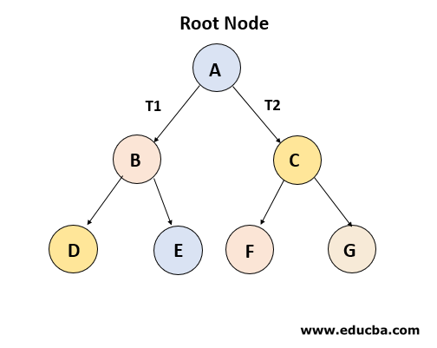
Binary Tree
The binary tree is the kind of tree in which most two children can be found for each parent. The kids are known as the left kid and right kid. This is more popular than most other trees. When certain constraints and characteristics are applied in a Binary tree, a number of others such as AVL tree, BST (Binary Search Tree), RBT tree, etc. are also used. When we move forward, we will explain all these styles in detail.

Slide 72
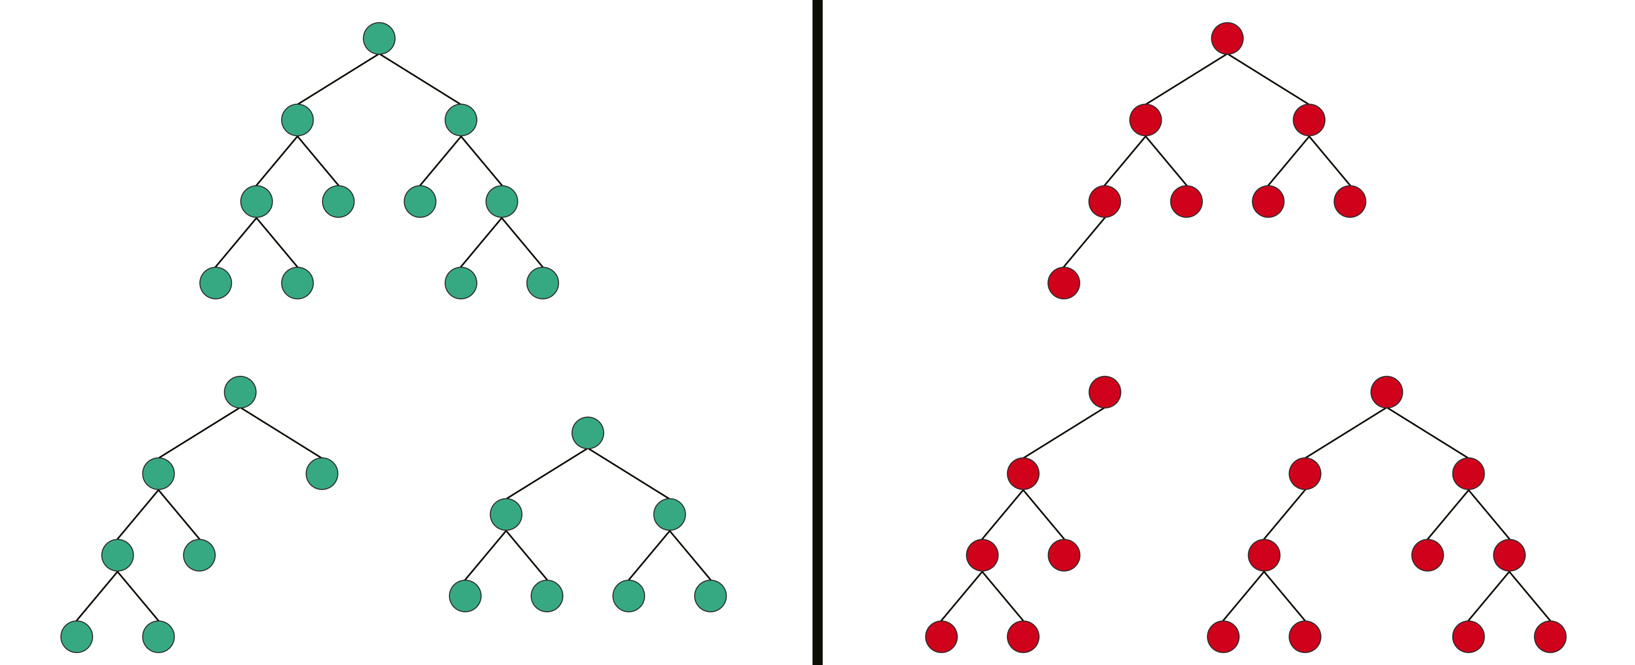
Types Of Binary Tree
Full Binary Tree:- is a Binary Tree in which every node has 0 or 2 children.

Slide 73
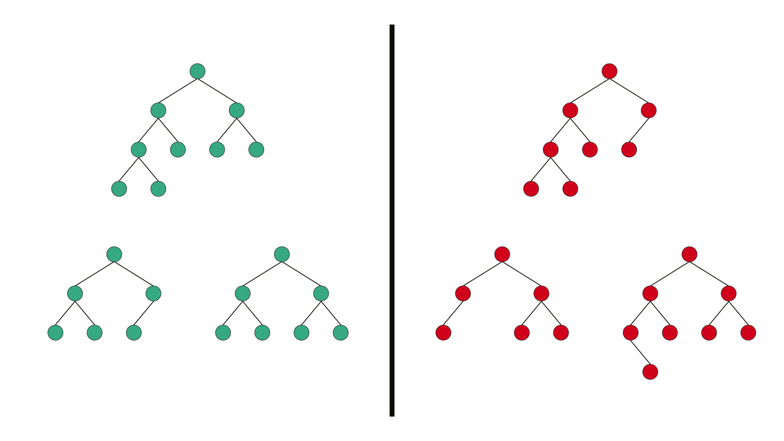
Types Of Binary Tree
Complete Binary Tree:- has all levels completely filled with nodes except the last level and in the last level, all the nodes are as left side as possible.

Slide 74
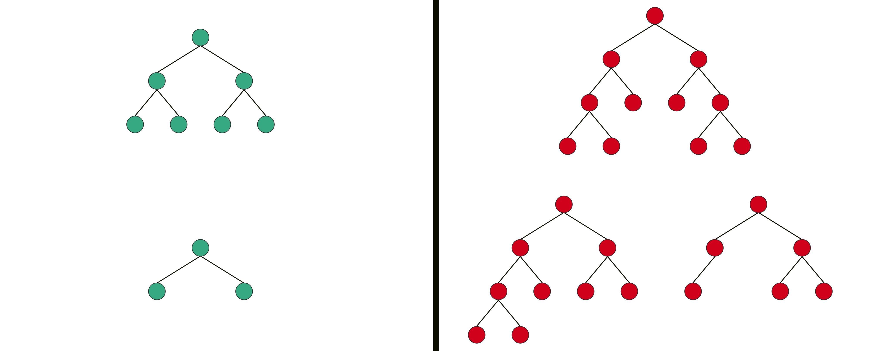
Types Of Binary Tree
Perfect Binary Tree:- is a Binary Tree in which all internal nodes have 2 children and all the leaf nodes are at the same depth or same level.

Slide 75
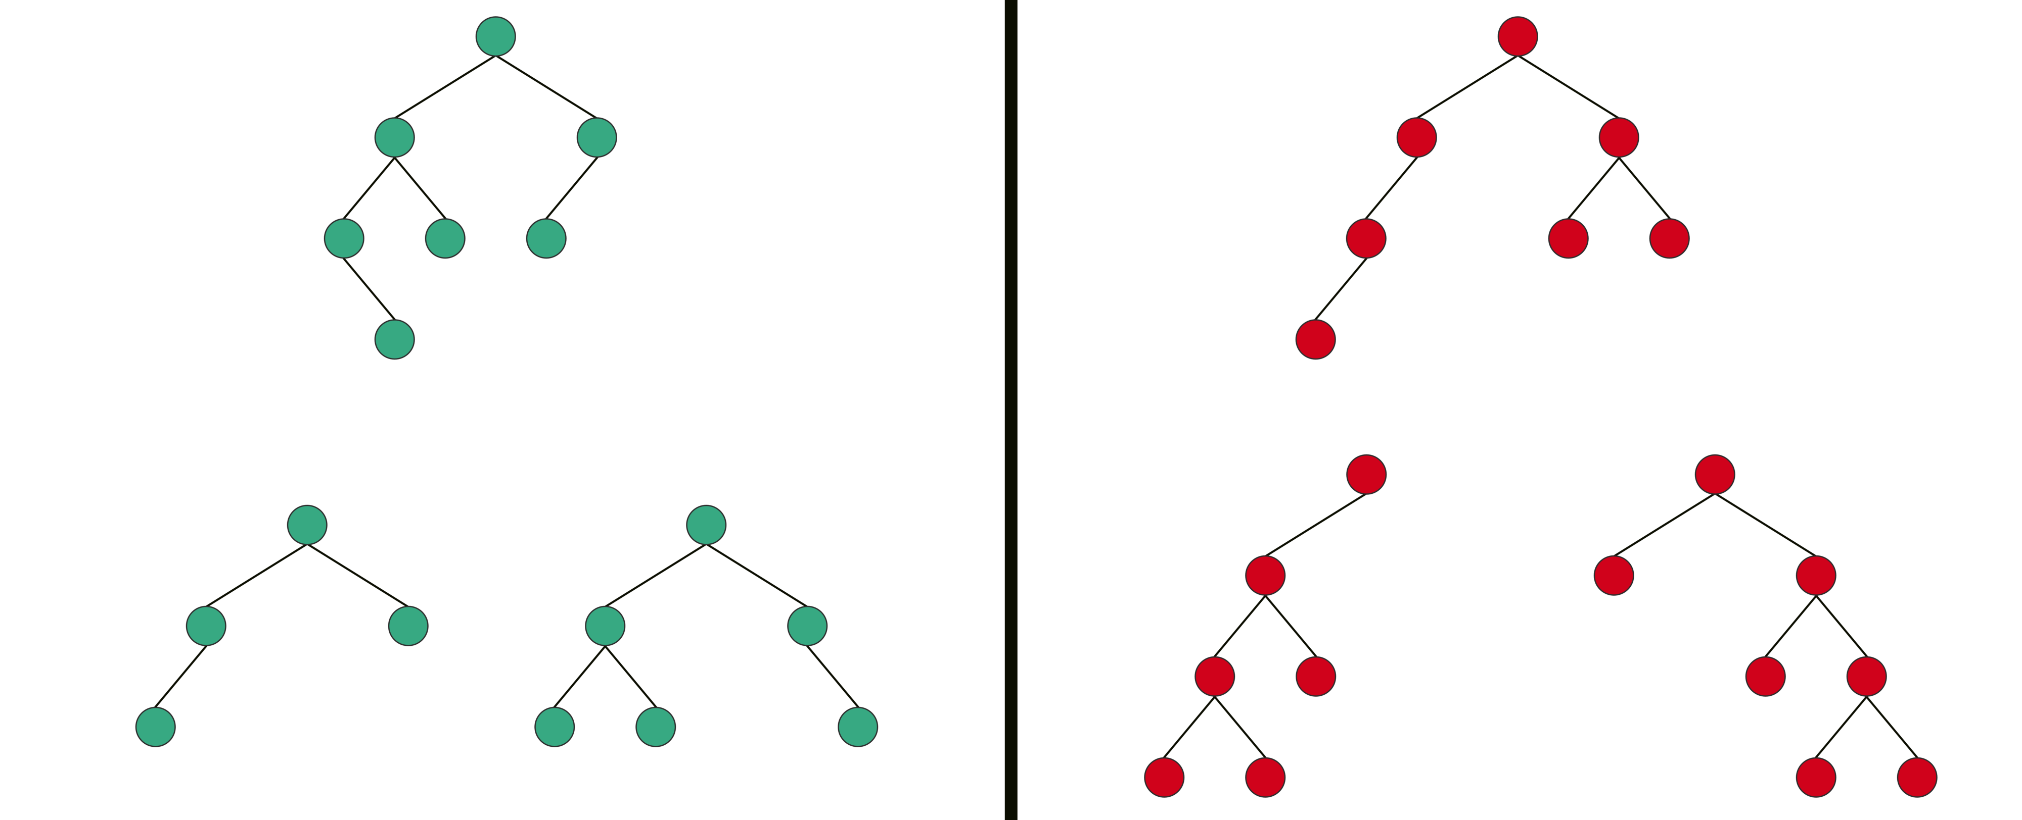
Types Of Binary Tree
Balanced Binary Tree:- is a Binary tree in which height of the left and the right sub-trees of every node may differ by at most 1

Slide 76
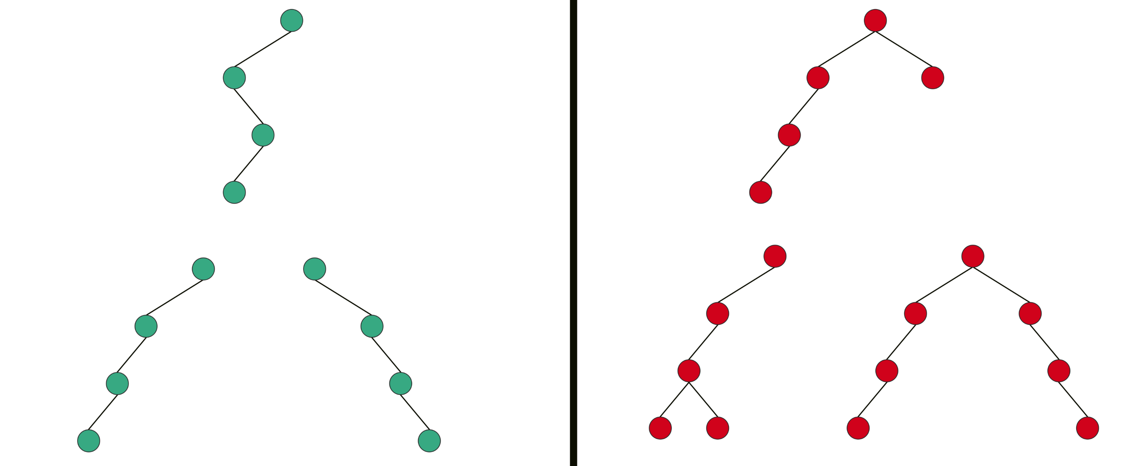
Types Of Binary Tree
Degenerate Binary Tree:- is a Binary Tree where every parent node has only one child node.

Slide 77
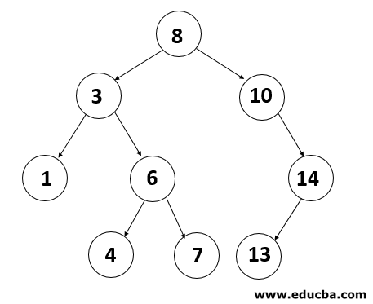
Binary Search Tree
Binary Search Tree (BST) is a binary tree extension with several optional restrictions. The left child value of a node should in BST be less than to the parent value and the right child value should always be greater than to the parent’s value.(vise versa) This Binary Search Tree property makes it ideal for search operations since we can accurately determine at each node whether the value is in the left or right sub-tree. This is why the Search Tree is named.

Slide 78
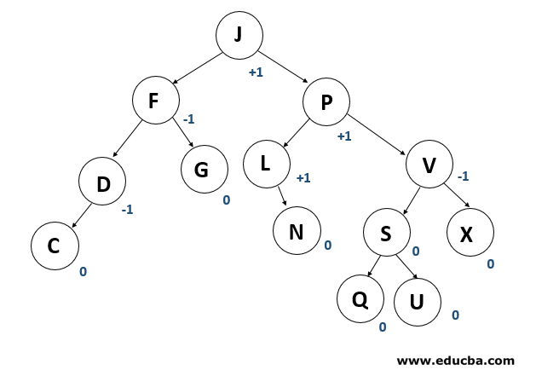
AVL Tree
AVL tree is a binary search tree self-balancing. On behalf of the inventors Adelson-Velshi and Landis, the name AVL is given.
This was the first tree that balanced dynamically. A balancing factor is allocated for each node in the AVL tree, based on whether the tree is balanced or not.
The height of the node kids is at most 1. AVL vine. In the AVL tree, the correct balance factor is 1, 0 and -1.
If the tree has a new node, then it will be rotated to ensure that the tree is balanced. It will then be rotated. Common operations such as viewing, insertion, and removal take O(log n) time in the AVL tree. It is mostly applied when working with Lookups operations.

Slide 79
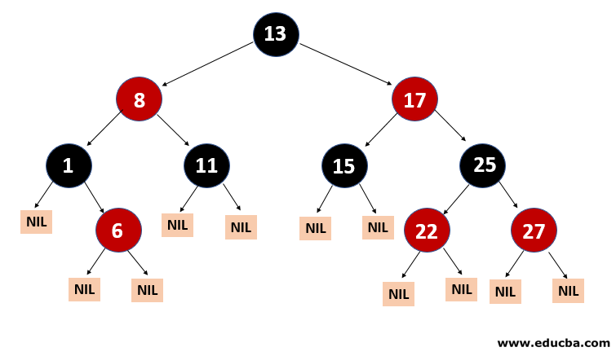
Red-Black Tree
Another kind of auto-balancing tree is red-black. The red-black name is given because the Red-black tree has either red or Black painted on each node according to the red-black tree’s properties.
It maintains the balance of the forest. Even though this tree is not a fully balanced tree, the searching operation only takes O (log n) time.
When the new nodes are added in Red-Black Tree then nodes will be rotated again to maintain the Red-Black Tree’s properties.

Slide 80
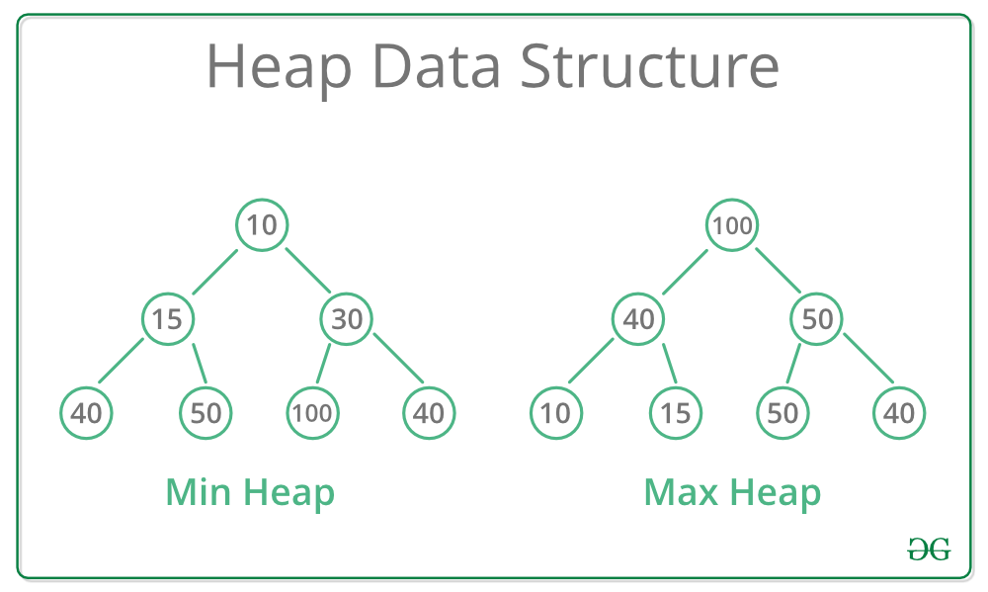
Heap Tree
A Heap is a special Tree-based data structure in which the tree is a complete binary tree. Generally, Heaps can be of two types:
Max-Heap: In a Max-Heap the key present at the root node must be greatest among the keys present at all of it’s children. The same property must be recursively true for all sub-trees in that Binary Tree.
Min-Heap: In a Min-Heap the key present at the root node must be minimum among the keys present at all of it’s children. The same property must be recursively true for all sub-trees in that Binary Tree.

Slide 81
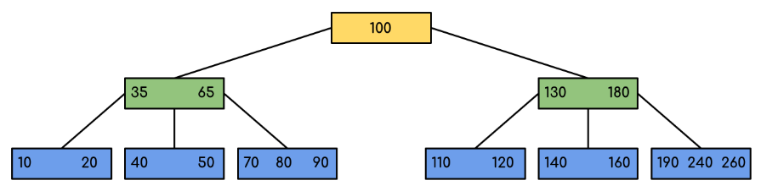
B Tree
B-Tree is a self-balancing search tree. In most of the other self-balancing search trees (like AVL and Red-Black Trees), it is assumed that everything is in main memory. When the number of keys is high, the data is read from disk in the form of blocks. Disk access time is very high compared to the main memory access time. The main idea of using B-Trees is to reduce the number of disk accesses. Most of the tree operations (search, insert, delete, max, min, ..etc ) require O(h) disk accesses where h is the height of the tree. B-tree is a fat tree. The height of B-Trees is kept low by putting maximum possible keys in a B-Tree node. Generally, the B-Tree node size is kept equal to the disk block size.

Slide 82
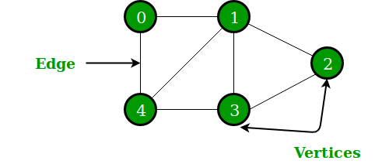
Graph
A graph data structure consists of a finite (and possibly mutable) set of vertices (also called nodes or points), together with a set of unordered pairs of these vertices for an undirected graph or a set of ordered pairs for a directed graph. These pairs are known as edges (also called links or lines), and for a directed graph are also known as arrows.
A Graph is a non-linear data structure consisting of nodes and edges. The nodes are sometimes also referred to as vertices and the edges are lines or arcs that connect any two nodes in the graph.
the set of vertices V = {0,1,2,3,4} and the set of edges E = {01, 12, 23, 34, 04, 14, 13}.

Slide 83
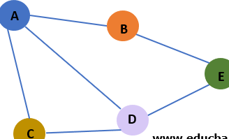
Graph Terminologies
Graph Representation:- Generally, a graph is represented as a pair of sets (V, E). V is the set of vertices or nodes. E is the set of Edges. V = { A, B, C, D, E } E = { AB, AC, AD, BE, CD, DE }
Node or Vertex: The elements of a graph are connected through edges.
Edges: A path or a line between two vertices in a graph.
Adjacent Nodes: Two nodes are called adjacent if they are connected through an edge.
Path: Path is a sequence of edges between two nodes. It is essentially a traversal starting at one node and ending at another. Path(A, E) = { AB, BE } OR Path(A, E) = { AC, CD, DE } OR Path(A, E) = { AD, DE }
Acyclic: Acycle can be defined as the path which has no repeated edges or vertices except the first and last vertices.
Loop: An edge that is associated with the similar end points can be called as Loop.
Degree: number of edges connected to it.(indegree, outdegree)
Source/Sink: a vertex with indegree zero is called source vertex, while a vertex with out degree zero is called sink vertex.
Isolated vertex: a vertex with degree zero is non as isolated vertex.
Adjacency Matrix / Adjacency List

Slide 84
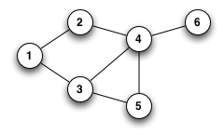
Undirected graph
An undirected graph is a graph in which edges have no orientation. The edge(x, y) is identical to the edge(y, x), i.e. they are not ordered pairs. The maximum number of edges possible in an undirected graph without a loop is n(n-1)/2

Slide 85
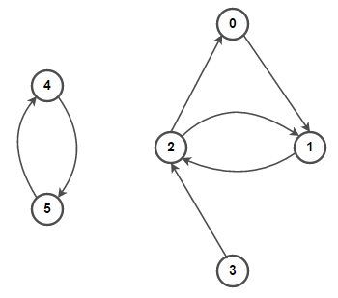
Directed graph
An directed graph(di-graph) is a graph in which edges have orientation. The edge(x, y) is not identical to the edge(y, x),

Slide 86
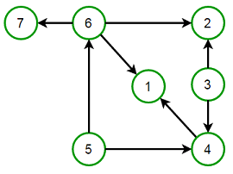
Directed Acyclic graph
An directed acyclic graph is a graph that contains no cycles.

Slide 87
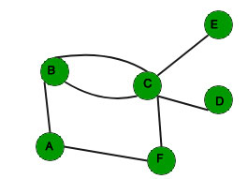
Multigraph
A multigraph is an undirected graph in which multiple edges(and sometimes loops) are allowed. Multiple edges are two or more edges that connect the same two vertices. A loop is an edge (directed or undirected) that connects a vertex to itself; it may be permitted or not, according to the application.

Slide 88
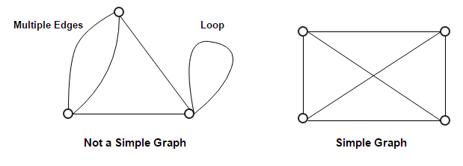
Simple graph
A simple graph, as opposed to a multigraph, is an undirected graph in which both multiple edges and loops are disallowed. In a simple graph with n vertices, the degree of every vertex is at most n -1.

Slide 89
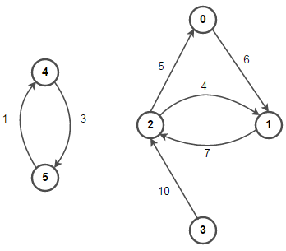
Weighted and Unweighted graph
A weighted graph associates a value(weight) with every edge in the graph. Words cost or length can also be used instead of weight.
An unweighted graph does not have any value(weight) associated with every edge in the graph. In order words, a weighted graph is a weighted graph with all edges weight as 1. Unless specified otherwise, all graphs are assumed to be unweighted by default.

Slide 90
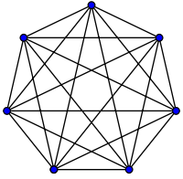
Complete graph
A complete graph is one in which every two vertices are adjacent: all edges that could exist are present.

Slide 91
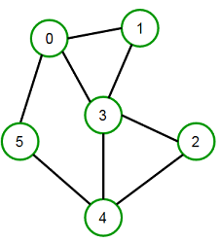
Complete graph
A connected graph has a path between every pair of vertices. In other words, there are no unreachable vertices. A disconnected graph is a graph which is not connected.

Slide 92
Graph Traversal
Graph traversal is a technique used for a searching vertex in a graph. The graph traversal is also used to decide the order of vertices is visited in the search process. A graph traversal finds the edges to be used in the search process without creating loops. That means using graph traversal we visit all the vertices of the graph without getting into looping path.
Traversal of a graph produces a spanning tree as final result. Spanning Tree is a graph without loops.
There are two graph traversal techniques and they are as follows...
DFS (Depth First Search) {Stack with size equal to number of vertex}
BFS (Breadth First Search) {Queue with size equal to number of vertex}

Slide 93
DFS (Depth First Search)
We use the following steps to implement DFS traversal...
Step 1 - Define a Stack of size total number of vertices in the graph.
Step 2 - Select any vertex as starting point for traversal. Visit that vertex and push it on to the Stack.
Step 3 - Visit any one of the non-visited adjacent vertices of a vertex which is at the top of stack and push it on to the stack.
Step 4 - Repeat step 3 until there is no new vertex to be visited from the vertex which is at the top of the stack.
Step 5 - When there is no new vertex to visit then use back tracking and pop one vertex from the stack.
Step 6 - Repeat steps 3, 4 and 5 until stack becomes Empty.
Step 7 - When stack becomes Empty, then produce final spanning tree by removing unused edges from the graph

Slide 94
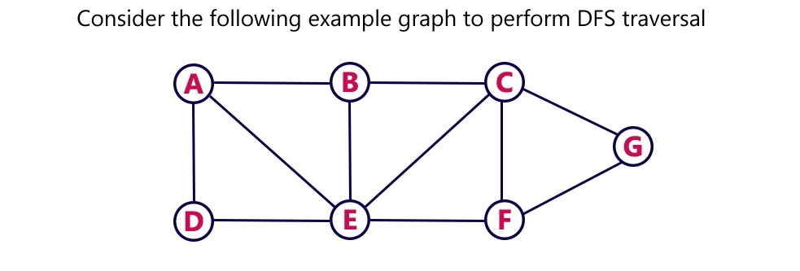
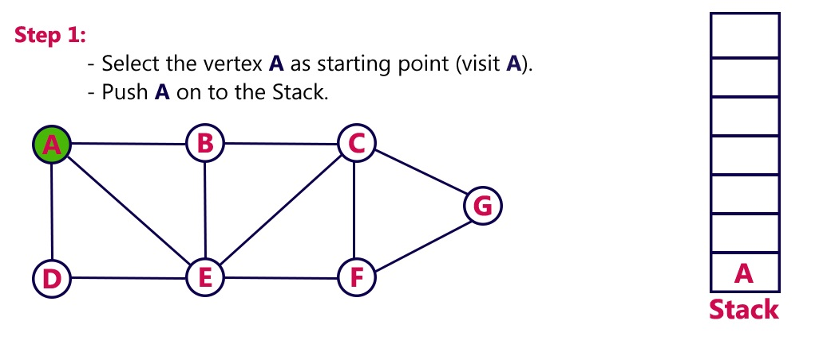
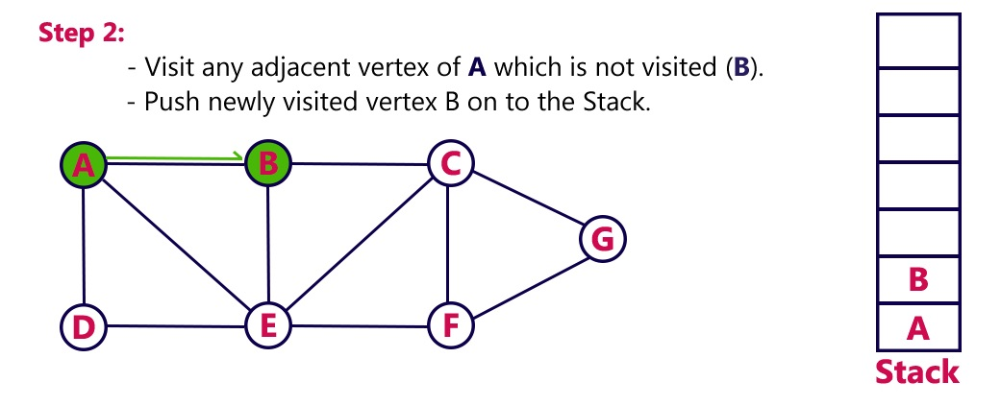
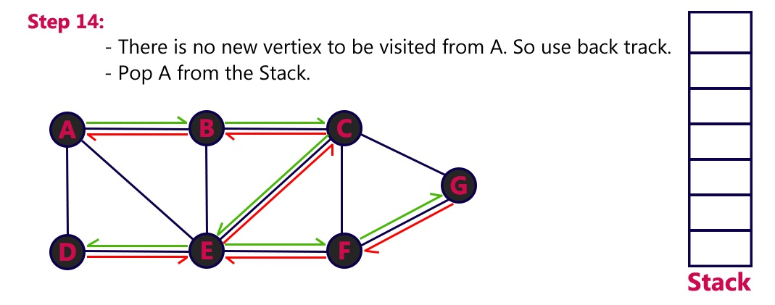
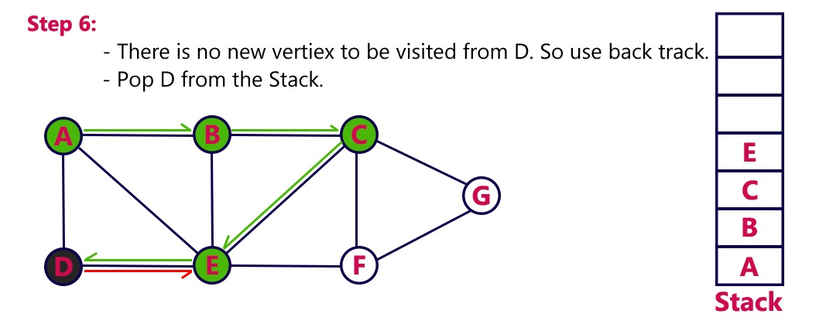
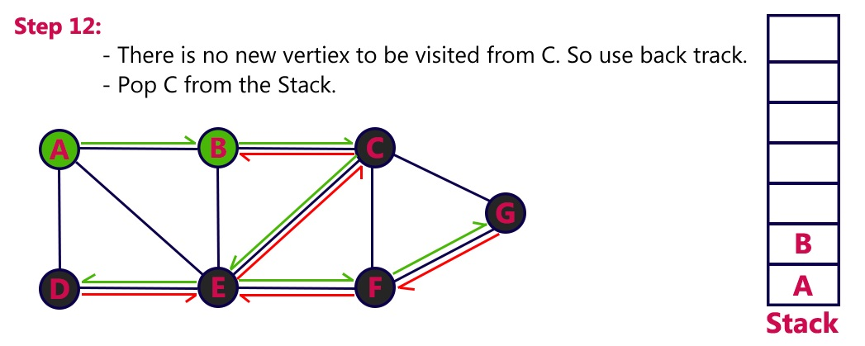
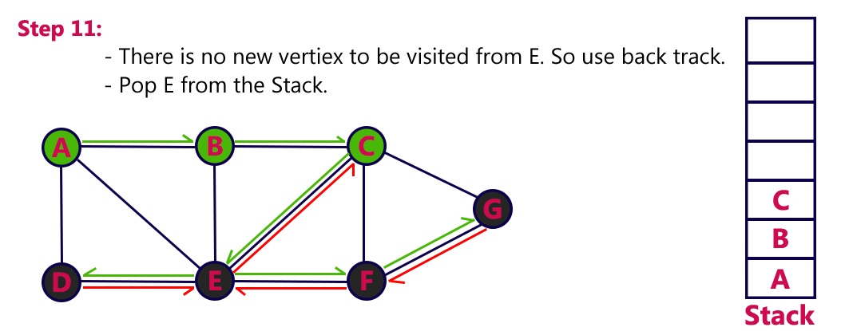
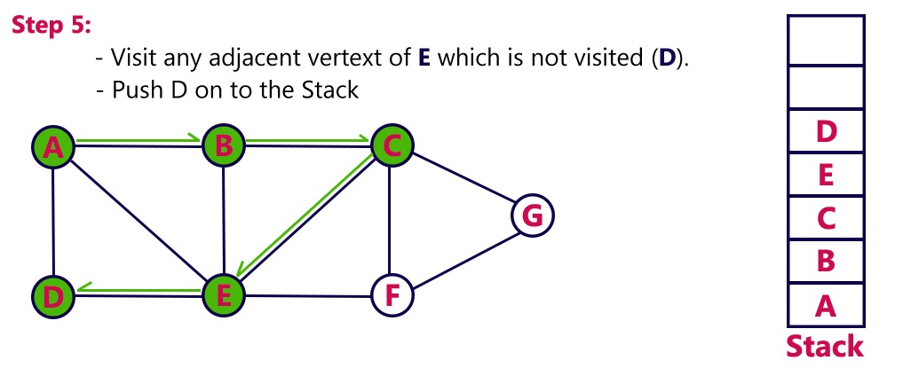
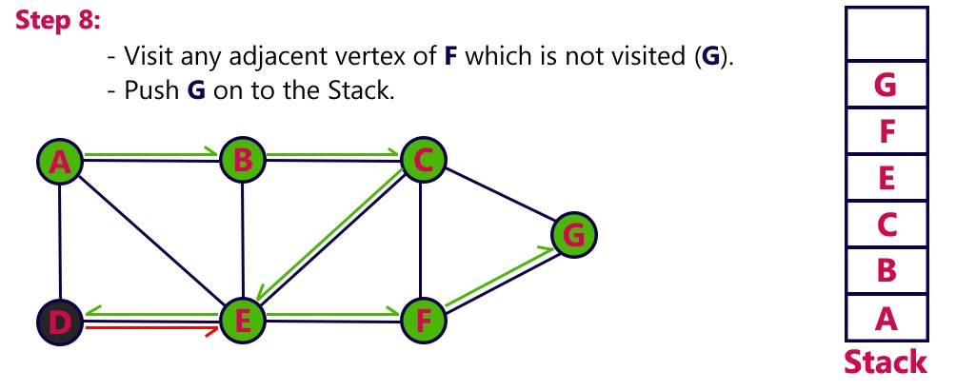
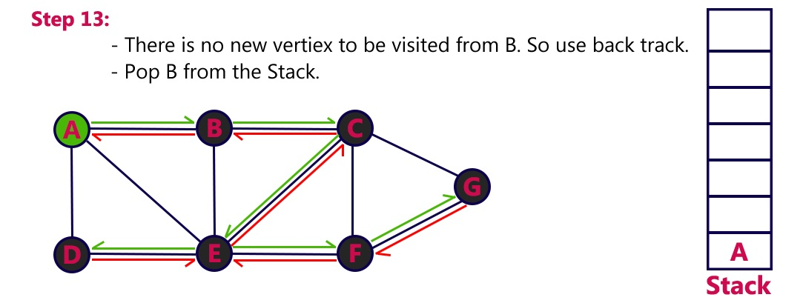
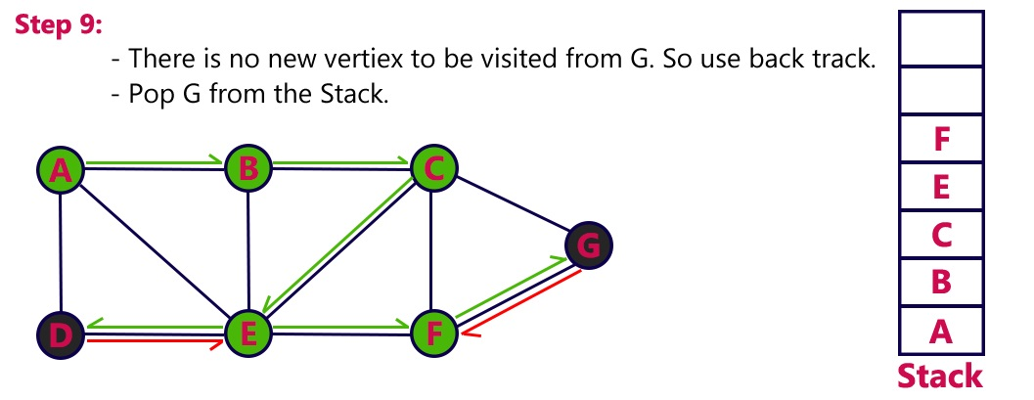
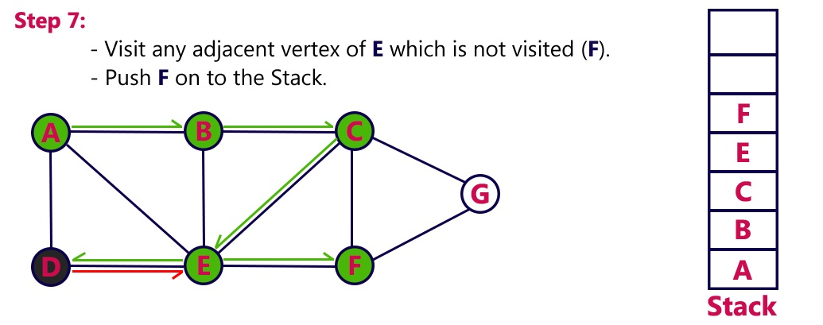
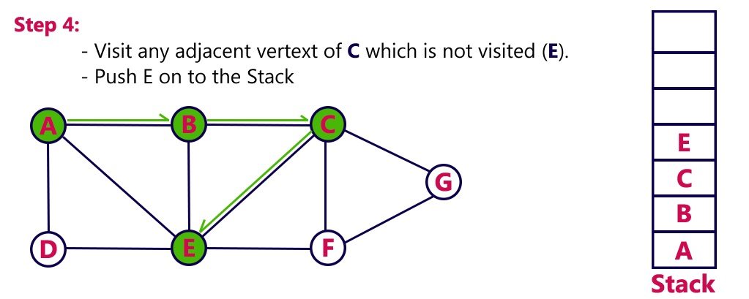
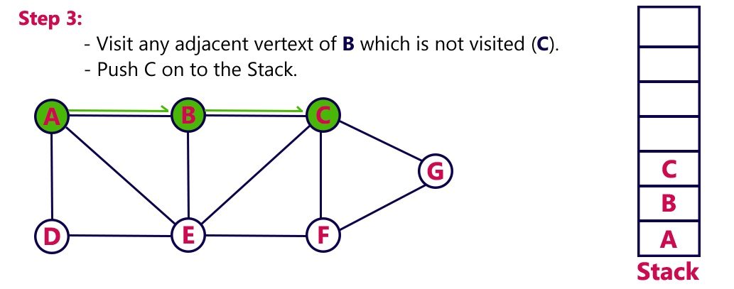
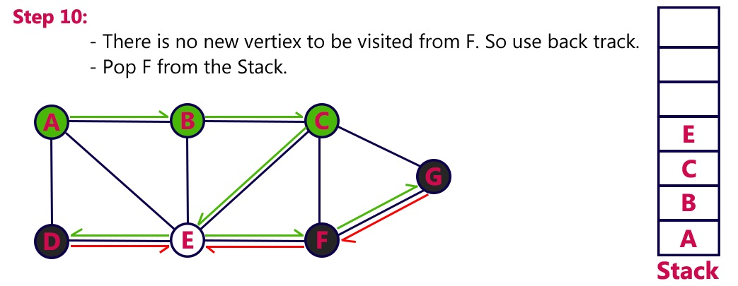
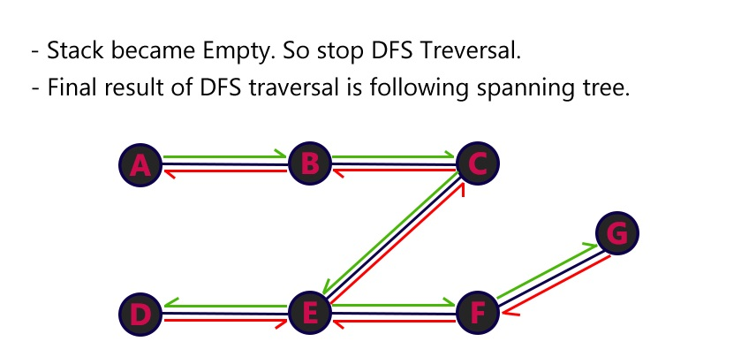
DFS (Depth First Search)

Slide 95
BFS (Breath first Search)
We use the following steps to implement BFS traversal...
Step 1 - Define a Queue of size total number of vertices in the graph.
Step 2 - Select any vertex as starting point for traversal. Visit that vertex and insert it into the Queue.
Step 3 - Visit all the non-visited adjacent vertices of the vertex which is at front of the Queue and insert them into the Queue.
Step 4 - When there is no new vertex to be visited from the vertex which is at front of the Queue then delete that vertex.
Step 5 - Repeat steps 3 and 4 until queue becomes empty.
Step 6 - When queue becomes empty, then produce final spanning tree by removing unused edges from the graph

Slide 96
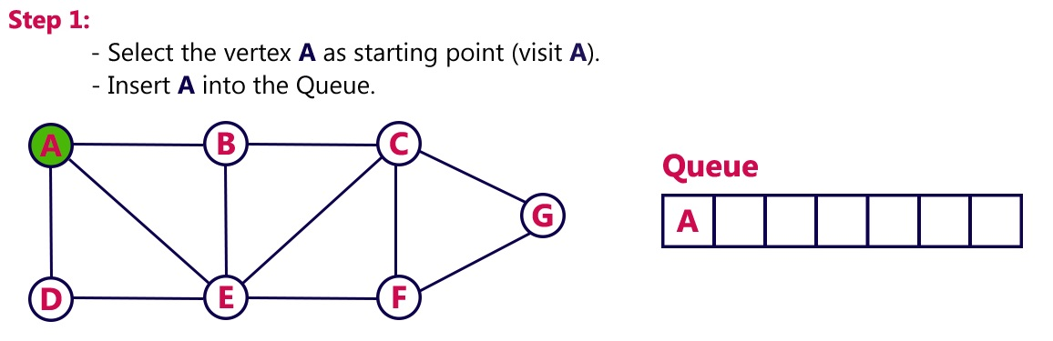
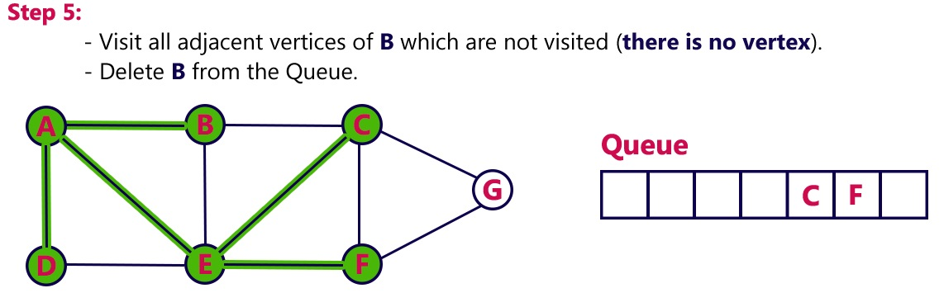
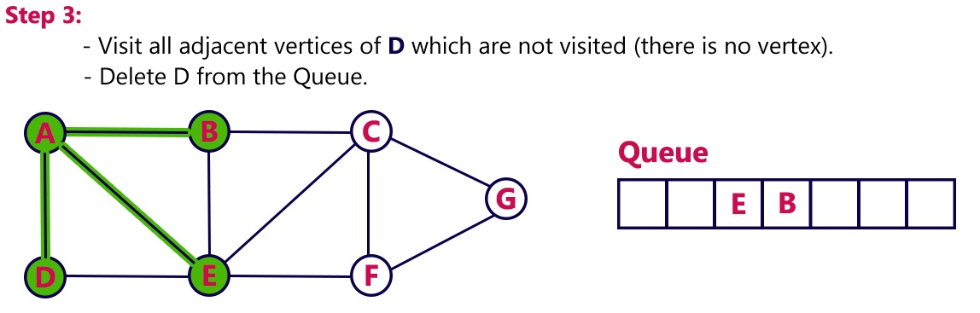
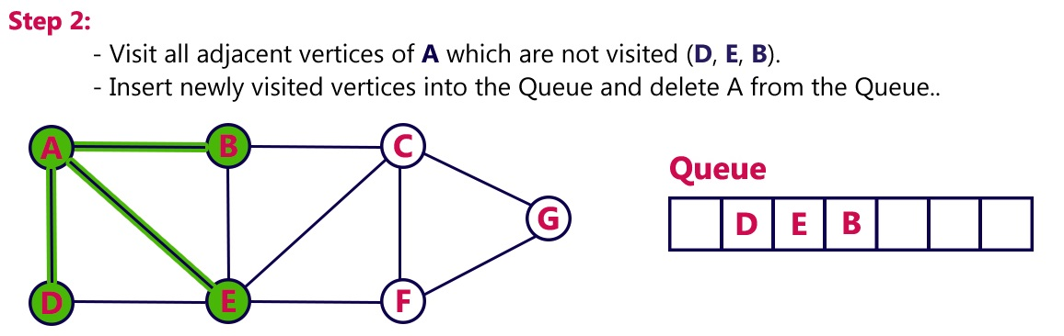
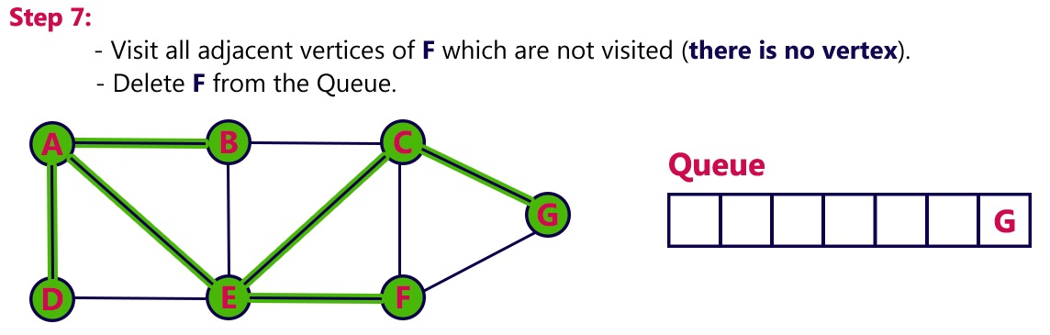
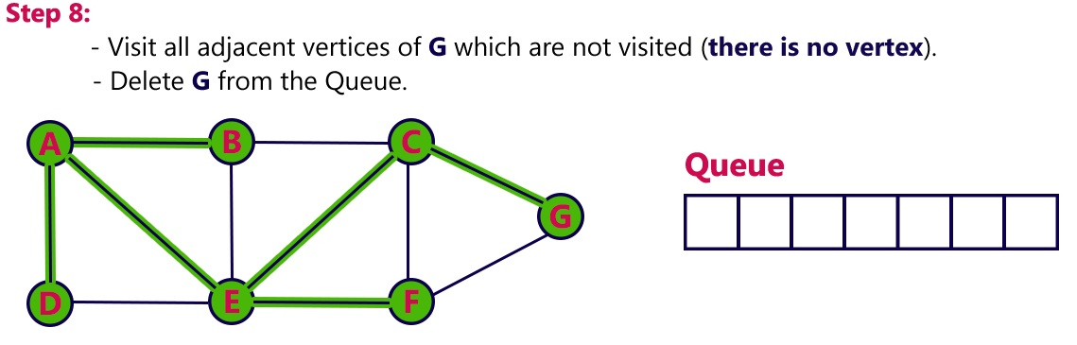




BFS (Breath first Search)

Slide 97
Minimum Spanning Tree (MST)
In a weighted graph, a minimum spanning tree is a spanning tree that has minimum weight than all other spanning trees of the same graph. In real-world situations, this weight can be measured as distance, congestion, traffic load or any arbitrary value denoted to the edges.
We shall learn about two most important spanning tree algorithms here −
Kruskal's Algorithm
Prim's Algorithm

Slide 98
Kruskal's Spanning Tree Algorithm
Kruskal's algorithm to find the minimum cost spanning tree uses the greedy approach. This algorithm treats the graph as a forest and every node it has as an individual tree. A tree connects to another only and only if, it has the least cost among all available options and does not violate MST properties.
Algorithm:-
Step 1 - Remove all loops and Parallel Edges
Step 2 - Arrange all edges in their increasing order of weight
Step 3 - Add the edge which has the least weightage

Slide 99










Kruskal's Spanning Tree Algorithm
Let us understand it with an example: Consider the below input graph.

Slide 100
Prim's Spanning Tree Algorithm
Prim's algorithm to find minimum cost spanning tree (as Kruskal's algorithm) uses the greedy approach. Prim's algorithm shares a similarity with the shortest path first algorithms.
Prim's algorithm, in contrast with Kruskal's algorithm, treats the nodes as a single tree and keeps on adding new nodes to the spanning tree from the given graph.
Algorithm:-
Step 1 - Remove all loops and Parallel Edges
Step 2 - Choose any arbitrary node as root node
Step 3 - Check outgoing edges and select the one with less cost

Slide 101






Prim's Spanning Tree Algorithm
Let us understand it with an example: Consider the below input graph.

Slide 102


Slide 103


Slide 104


Slide 105


